Slide 1
Assignement
SQL VS NoSQL
Mohamed Amine Ben Hmida

Slide 2
TABLE OF CONTENTS
01
04
DBMS Introduction
Key differnces
02
05
SQL Definition
Differences
03
06
NoSQL Definition
Major Use
Here you could describe
the topic of the section
Here you could describe
the topic of the section
Here you could describe
the topic of the section
Here you could describe
the topic of the section
Here you could describe
the topic of the section
Here you could describe
the topic of the section

Slide 3


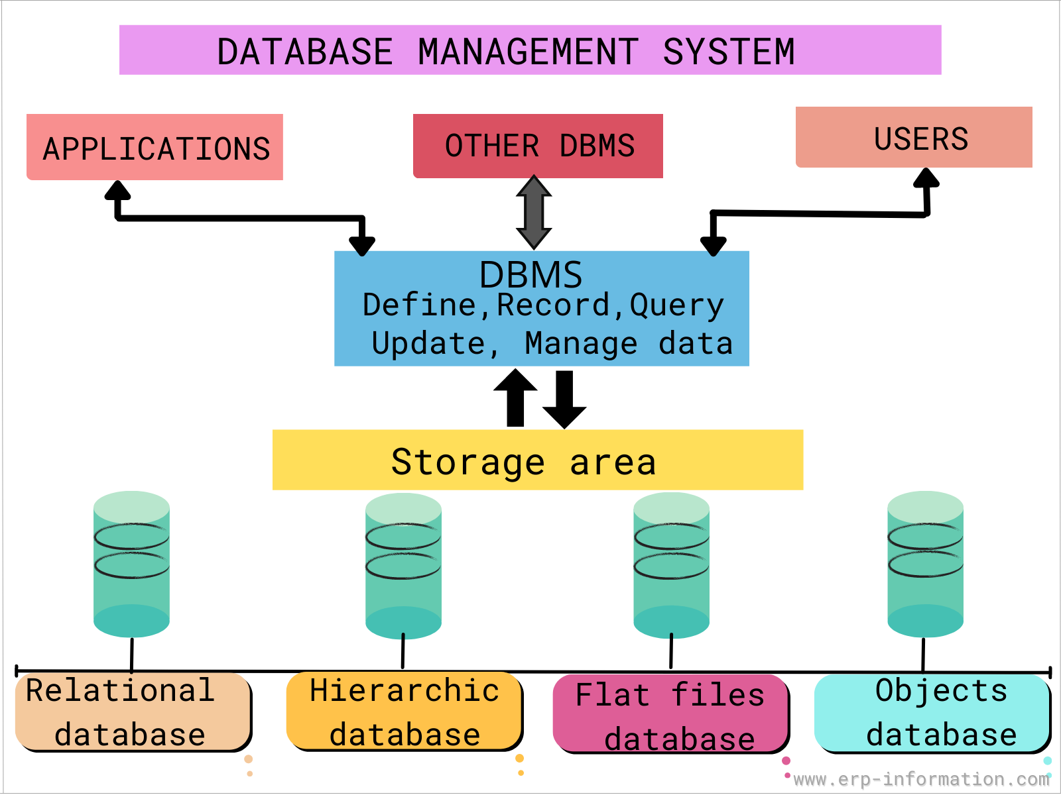
DBMS Introduction
The DBMS is the software that would be installed on your personal computer or on a server, then you would use it to manage one or more databases.
The database has your actual data and the rules about that data, while the DBMS is the program that surrounds and manages your actual data, and it enforces the rules you specified on your data. The rules for example could be the type of the data, like integer or string, or the relationship between them

Slide 4
Definition of a Database
Collects Data
Manipulate Data
Simplify Data
Stores Data

Slide 5

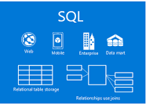
SQL Definition
Structured Query language (SQL) is the standard language for dealing with Relational Databases. A relational database defines relationships in the form of tables.
QL programming can be effectively used to insert, search, update, delete database records.

Slide 6
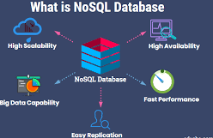
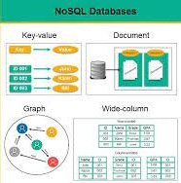
NoSQL Definition
NoSQL is a non-relational DMS, that does not require a fixed schema, avoids joins, and is easy to scale. NoSQL database is used for distributed data stores with humongous data storage needs. NoSQL is used for Big data and real-time web apps.

Slide 7
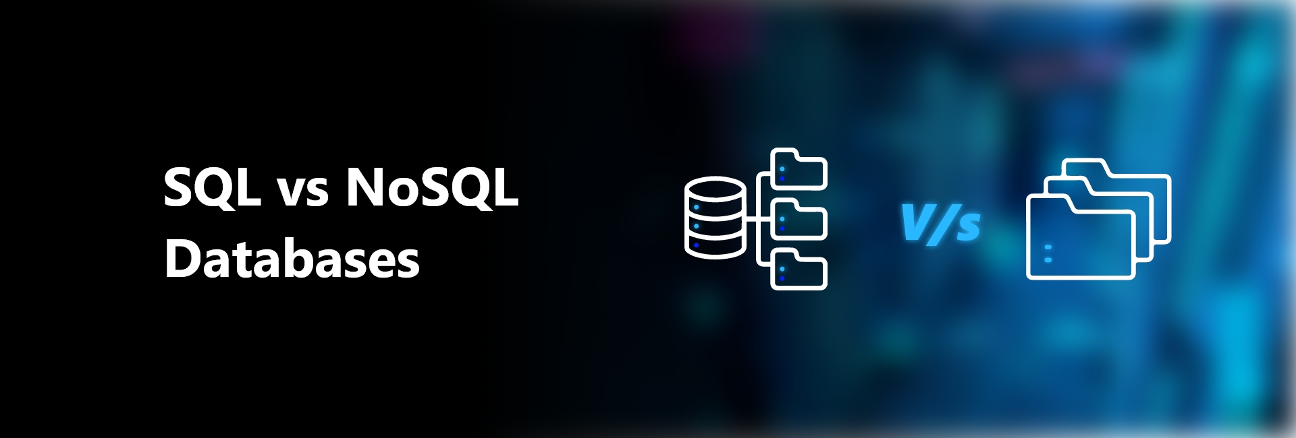
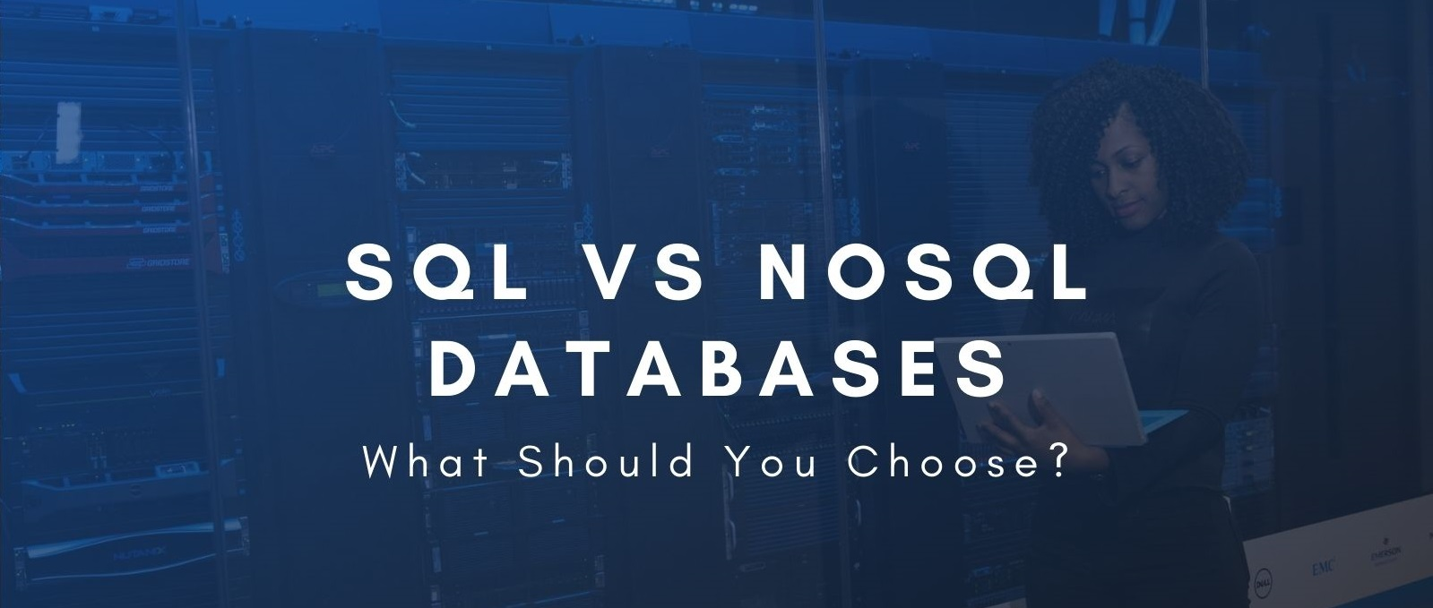
There are five practical differences between SQL and NoSQL:
Type
Scalability
Structure
Properties
Support and communities
Key Differences

Slide 8
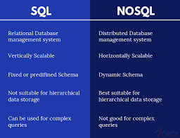
Differences

Slide 9
SQL VS NoSQL
Relational
vertically scalable
SQL
NoSQL
dynamic schemas
Document, key-value, graph
table based
predefined schema
Non Relational
horizontally scalable

Slide 10
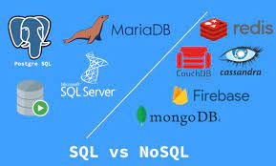
Major Use

Slide 11
Conclusion
Selecting or suggesting a database is a key responsibility for most database experts, and “SQL vs. NoSQL'' is a helpful rubric for informed decision-making. When considering either database, it is also important to consider critical data needs and acceptable tradeoffs conducive to meeting performance and uptime goals.

Slide 12
THANKS!
Does anyone have any question?
addyouremail@freepik.com
+216 52 982 300

